Slide 1
Classification Model for Thyroid Disease
Xu Fei, Qiu Yinan

Slide 2
Classification Model
for Thyroid Disease
1
【Introduction】
2
【Methodology】
3
【Data】
4
【Result】
5
【Conclusion】

Slide 3
Introduction
This project is focus on constructing a model to tell if the measurements comes from a person who is normal, or suffers from being hypothyroid or hyperthyroid. The data for this project are 7200 observations representing patients. 5000 of them are training data, and the other 2200 sample are testing data, and there are 21 variables.
In this project, Fisher Index for each variable is calculated, variable is ranked according to Fisher Index.
For this project, we construct two basic model, one is with KNN (K-Nearest Neighbor) classifier, and another one is the MLP (Multi-Layer Perceptron) classifier. And at last, we make a committee machine to improve the result.
Notes:
5

Slide 4
Methodology
Fisher Index
KNN (K-Nearest Neighbor) classifier
MLP (Multi-layer Perceptron) classifier
Committee Machine
Cross-Validation

Slide 5
Data
We are given the file thyroidTrain.mat, which contains the matrices trainThyroidInput (5000 × 21), trainThyroidOutput (5000 × 3), and testThyroidInput (2200 × 21).
Use the covariance to see the relation between the input and each class.
Use Fisher Index to estimate if a variable is useful for classification or not.
Use Pearson’s correlation coefficient to see if there are some relations between two variables.

Slide 6
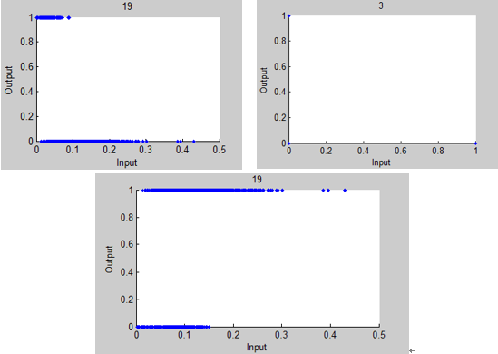
Data
The result of the Fisher Index: 17,21,19,18,10,3,20,2,16,1,7,13,8,6,4,12,14,11,5,9,15.
The relation between input and output

Slide 7
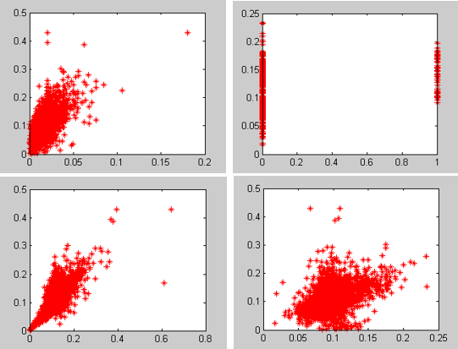
Data
the relation between variables

Slide 8
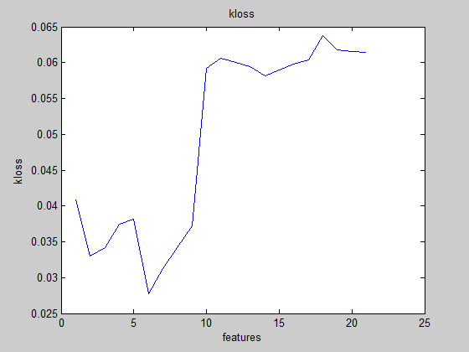
Result
KNN Classifier
The result for choose the best K
1 | 0.0754
2 | 0.0714
3 | 0.0612
4 | 0.0632
5 | 0.0620
6 | 0.0640
7 | 0.0614
8 | 0.0614
9 | 0.0636
10 | 0.0636
relation between features and kloss

Slide 9
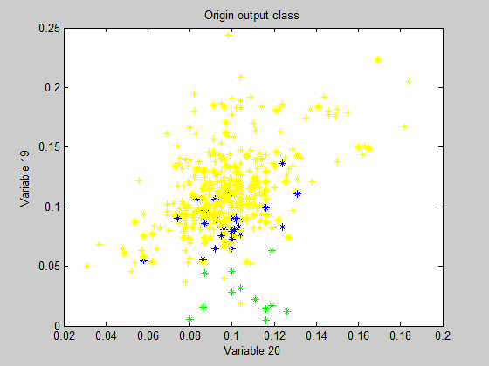
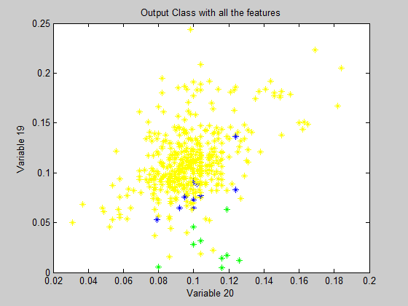
Result
KNN Classifier

Slide 10
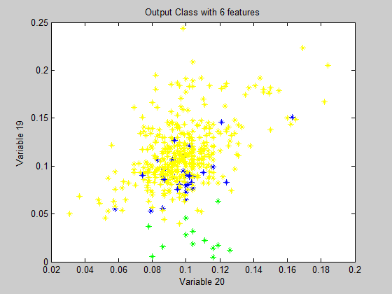
Results
KNN Classifier

Slide 11
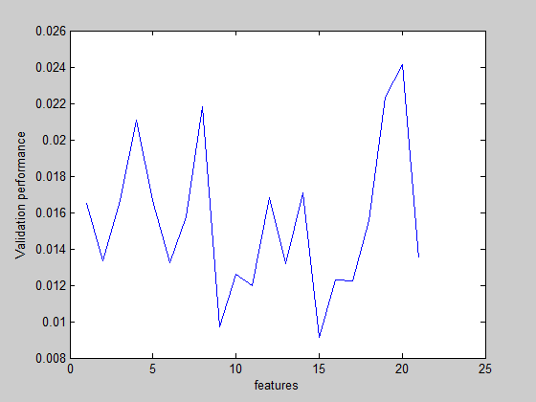
Results
MLP Classifier
The result for choose the hidden nodes
4 | 0.0113
5 | 0.0152
6 | 0.0129
7 | 0.0141
8 | 0.0179
9 | 0.0181
10 | 0.0143
relation between features and
validation performance

Slide 12
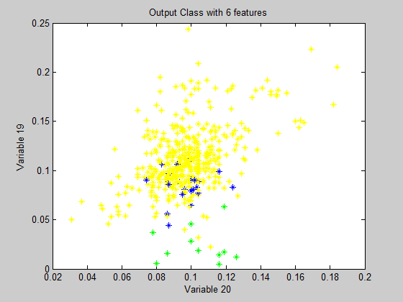
Results
MLP Classifier

Slide 13
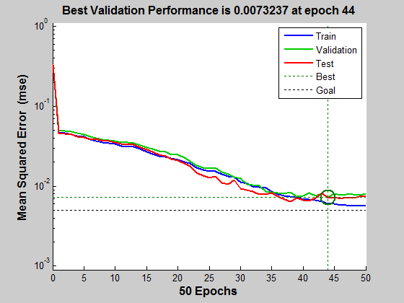
Results
MLP Classifier
 | Generalize Error
KNN Classifier | 0.0256
MLP Classifier | 0.0073
Committee Machine | 0.0073

Slide 14
Conclusion
For this project, we can get the conclusion from the result that committee machine should have the best result, but in this project, the committee machine only have two models, so the committee machine will be partial to the model with smaller MSE. Between the KNN classifier model and the MLP classifier model, the MLP classifier have better result, in my opinion, I think it’s because the construct and the method of the KNN classifier, the method itself with more errors. For more development, I think I should do more test for the data, to move the outliers.

Slide 15
Regression Model for cooling in a H2O2 process

Slide 16
Regression Model for
cooling in a H2O2 process
1
【Introduction】
2
【Methodology】
3
【Data】
4
【Result】
5
【Conclusion】

Slide 17
Introduction
This project is focus on constructing a model for cooling a H2O2 process. This is a non-linear regression task. The process that generated the data is EKA chemicals Hydrogen Peroxide production.
In this project, I used linear regression, stepwise regression, PCA, PLS and MLP to construct the model. Among all the models, the linear regression combine with forward selection and backward elimination shows the best performance.
Notes:
5

Slide 18
Methodology
Covariance and Correlation Estimation
Linear Regression and Stepwise regression
Cross-Validation
PCA (Principal Component Analysis)
PLS (Partial Least-Squares)
MLP (Multi-Layer Perceptron)

Slide 19
Methodology
Robust regression works by assigning a weight to each data point. Weighting is done automatically and iteratively using a process called iteratively reweighted least squares. In the first iteration, each point is assigned equal weight and model coefficients are estimated using ordinary least squares. At subsequent iterations, weights are recomputed so that points farther from model predictions in the previous iteration are given lower weight. Model coefficients are then recomputed using weighted least squares. The process continues until the values of the coefficient estimates converge within a specified tolerance.

Slide 20
Data
In this regression problem, data consists 3 matrix: XtrainDS (4466x65), YtrainDS (4466x1) and XtestDS (2971x65). All input variable of the process is contained in XtrainDS and output matrix YtrainDS present the output value, which is the valve opening.
Use the covariance to see the relation between the input and each class.
Use the Cook’s Distance to move the outliers
Use the residual histogram to move the outliers again

Slide 21
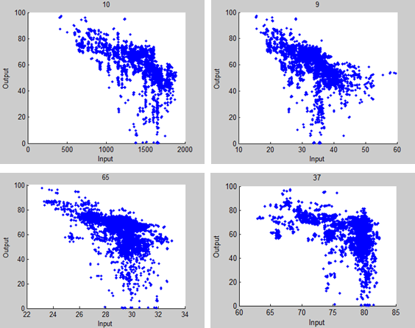
Data
The relation between input and output

Slide 22
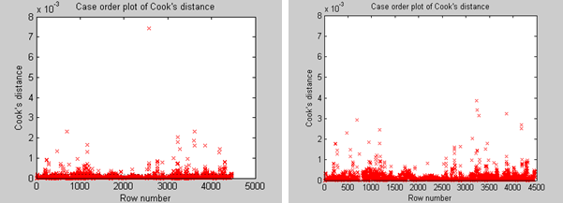
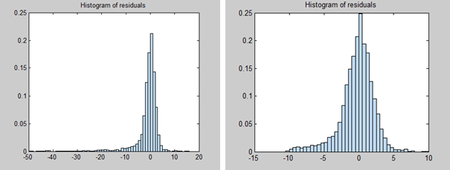
Data
Case order plot of
Cook’s distance
Histogram of residuals

Slide 23
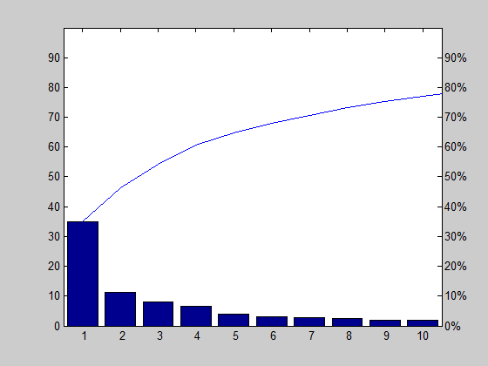
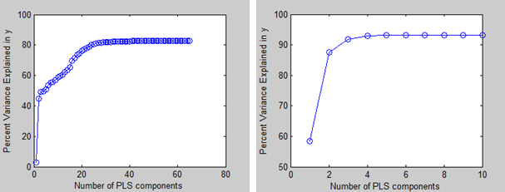
Data
PCA
Relation between PLS components and percent variance in Y

Slide 24
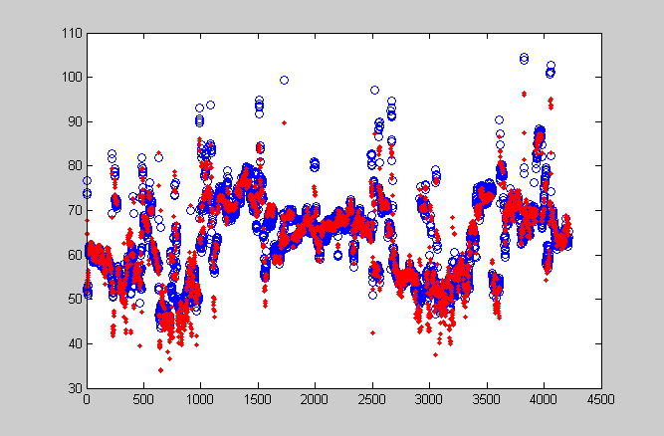
Results
Linear Regression
Fit plot of the Linear-Stepwise regression

Slide 25
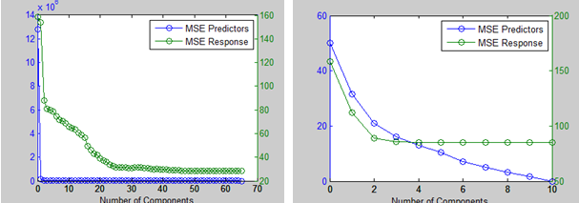
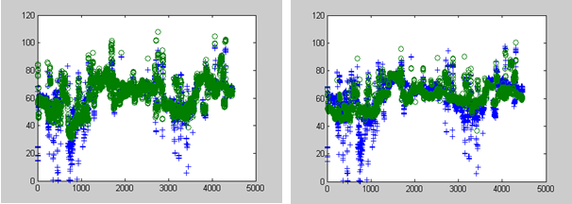
Results
PLS Regression
Relation between
components
and MSE
Fit plot of the
PLS regression

Slide 26
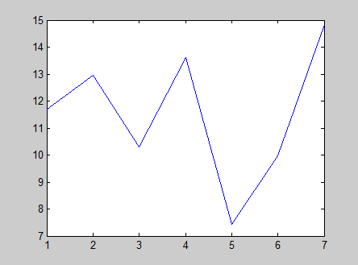
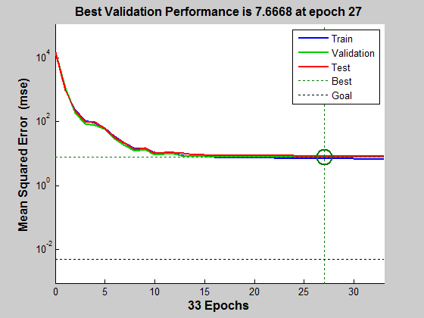
Results
MLP Regression
MLP node number test for variable final set
Performance of the MLP

Slide 27
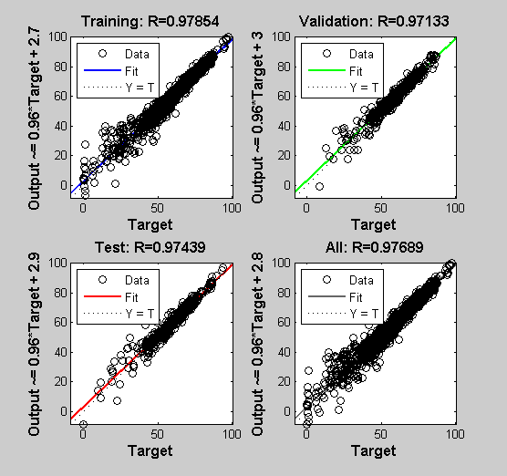
Results
MLP Classifier
Regression of the MLP

Slide 28
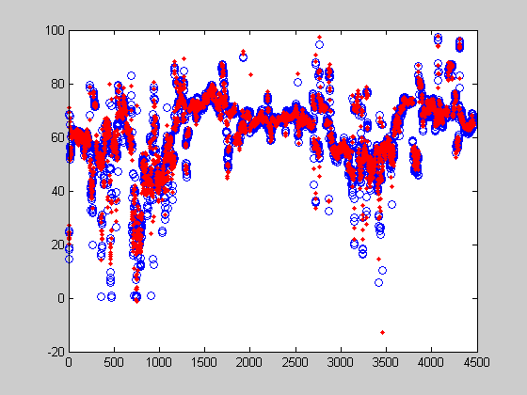
Results
MLP Classifier
Fit plot of the MLP regression.
 | MSE
Linear Regression | 5.7227
PLS Regression | 28.2331
MLP Regression | 6.7328.

Slide 29
Conclusion
For this project, we can get the conclusion from the result that committee machine have the best result for fit. Between the Linear Regression model, PLS Regression model and the MLP Regression model, the Linear Regression model have best result. In my opinion, I think it’s because the data, I use the function to move the outlier in Linear Regression model, so I use the XtrainDS exclude the outliers, but the others two model I didn’t use the XtrainDS exclude the outliers, that’s one reason for the Linear Regression is the best, but the PLS Regression should be the worst model for this project, because there isn’t a lot relation between the input variables.

Slide 30
Thank You!

